Slide 1
Chap6 Games
Textbook: “Networks, Crowds, and Markets : Reasoning about a Highly Connected World”

Slide 2
6.1 What is a Game?
Situation
the happiness of each participant with the outcome depends not just on his or her own decisions but on the decisions made by everyone

Slide 3
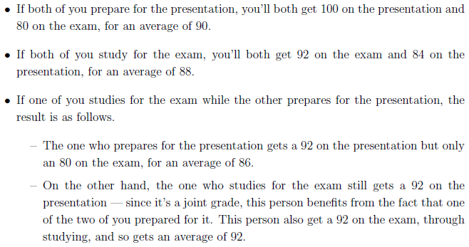
(G1) Exam-or-Presentation Game

Slide 4
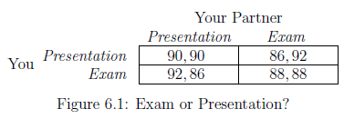
(G1) Exam-or-Presentation Game

Slide 5
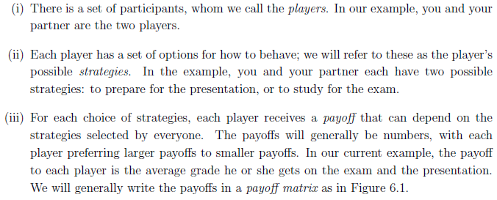
Three Ingredients of a Game
Players, strategies, and payoffs

Slide 6
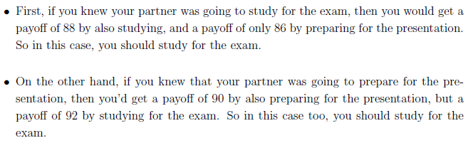
Reasoning about Behavior
Consider each of your partner’s options SEPARATELY

Slide 7
Exam-or-Presentation game:: conclusion
No matter what your partner does, you should study for the exam.
Strictly dominant strategy
When a player has a strategy that is strictly better than all other options regardless of what the other player does
Expect an average grade of 88. Why?
Studying for the exam is also a strictly dominant strategy for your partner

Slide 8
Striking phenomenon
You can do better
If you and your partner could somehow agree that you would both prepare for the presentation ➔ each get an average grade of 90!
However, this payoff of 90 cannot be achieved!
Your partner study for the exam so as to achieve a payoff of 92 for himself…
Rational Play
You and your partner only care about maximizing your own average grade

Slide 9
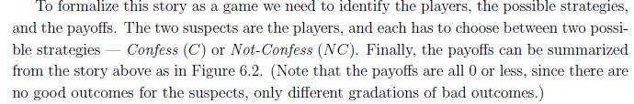
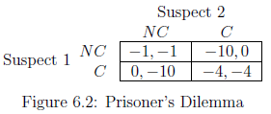
(G2) The Prisoner’s Dilemma

Slide 10
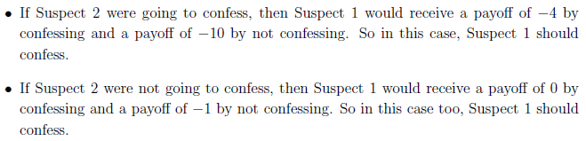
How one of the suspects should reason about his options
➔ Confessing is a strictly dominant strategy
➔ Difficulty in establishing cooperation in the face of individual self-interest

Slide 11
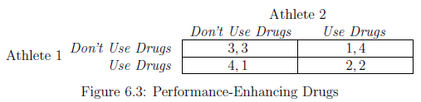
(G3) Performance-Enhancing Drugs Game
Using drugs is a strictly dominant strategy
“Arms races”
Two competitors use an increasingly dangerous arsenal of weapons simply to remain evenly matched

Slide 12
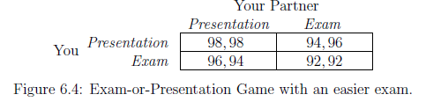
(G4) Exam-or-Presentation Game with an easier exam
Even simple changes to a game can change it from the Prisoner’s Dilemma something more benign
Example
We make the exam much easier so that you’ll get a 100 in it if you study, and a 96 if you don’t

Slide 13
Two important concepts in Game Theory :: Best Responses and Dominant Strategies
Best Response
The best choice of one player, given a belief about what the other play will do
S: a strategy chosen by Player 1 T: a strategy chosen by Player 2
As a result of the strategy (S, T), P1(S, T): the payoff to Player 1 P2(S, T): the payoff to Player 2
A strategy S for Player 1 is a best response to a strategy T for Player 2 if P1(S, T) ≥ P1(S’, T) for all other strategies S’ of Player 1
Strict best response if P1(S, T) > P1(S’, T)

Slide 14
Dominant Strategy
Dominant Strategy for Player 1
A strategy that is a best response to every strategy of Player 2
Strictly Dominant Strategy for Player 1
A strategy that is a strict best response to every strategy of Player 2
A dominant strategy is weaker than strictly dominant strategy
A player could potentially have multiple dominant strategies ➔ Not obvious which one should be played

Slide 15
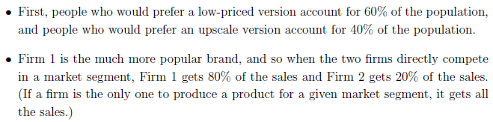
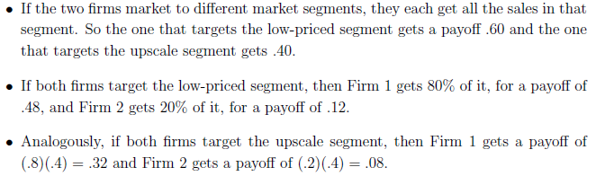
A Game in Which Only One Player Has a Strictly Dominant Strategy

Slide 16
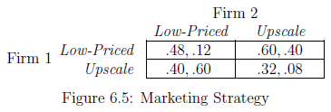
(G5) Marketing Strategy Game
For Firm 1, Low-Priced is the strictly dominant strategy
Firm 2 does not have a dominant strategy
Low-Priced is the best response when Firm 1 plays Upscale
Upscale is the best response when Firm 1 plays Low-Priced

Slide 17
Fortunately, we can predict the outcome of this game. Why?
Firm 1 will play its strictly dominant strategy, Low-Priced
Upscale is the strict best response by Firm 2 to Low-Priced
Low-Priced by Firm 1 and Upscale by Firm 2
Payoffs of .60 and .40 respectively
Common knowledge of the game
Firm 2 knows that Firm 1 wants to maximize profits
Firm 2 knows that Firm 1 knows its own profits

Slide 18
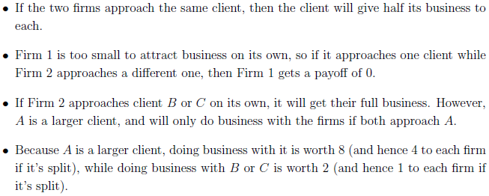
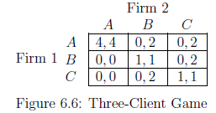
What if no player has a SDS? Example: (G6)A Three-Client Game
➔ Neither player has a SDS! ➔ Q: How can we reason about the outcome of this game?

Slide 19
Nash Equilibrium
Suppose
Player 1 chooses a strategy S
Player 2 chooses a strategy T
(S, T) is a Nash Equilibrium if
S is the best response to T AND
T is the best response to S
Main Idea
If the players choose strategies that are best responses to each other,
Then no player has an incentive to deviate to an alternative strategy ➔ Equilibrium state

Slide 20
Question
Why a pair of strategies that are not best responses to each other would not be an equilibrium?
Answer
The players cannot both believe that these strategies will be actually used in the game, as they know that at least one player would have an incentive to deviate to another strategy.
If each player believes that the other player will actually play a strategy that is part of a Nash equilibrium, then she is willing to play her part of the Nash equilibriuym
Overall Nash equilibrium = equilibrium in belief

Slide 21
(G6)A Three-Client Game
If Firm 1 chooses A and Firm 2 chooses A, then
Firm 1 is playing a best response to Firm 2’s strategy AND
Firm 2 is playing a best response to Firm 1’s strategy
Therefore
Nash equilibrium is (A, A)
Also
(A, A) is the only Nash equilibrium

Slide 22
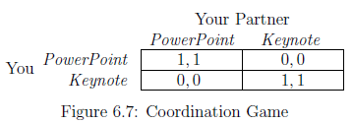
Multiple Equilibria (G7) Coordination Game
Situation
Suppose you and a partner are each preparing slides for a joint project presentation; you can’t reach your partner by phone, and need to start working on the slides now
Difficulty
Two Nash Equilbria (PowerPoint, PowerPoint) (Keynote, Keynote)

Slide 23
Choosing among multiple Nash Equilibria
Focal point
In some games, there are natural reasons that cause the players to focus on one of the Nash equilibria
e.g. two drivers approaching at night on an undivided country road

Slide 24
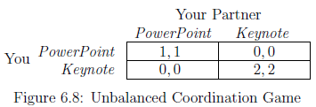
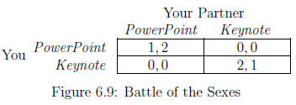
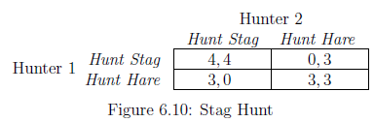
Variants on the Basic Coordination Game
(G10) Stag Hunt Game
If the two players miscoordinate, the one who was trying for the higher-payoff outcome gets penalized more than the one who was trying for the lower-payoff outcome.
(In fact, the one trying for the
lower-payoff outcome doesn't get penalized at all.)

Slide 25
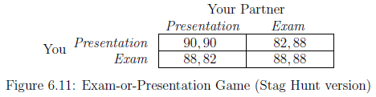
The structure of (G11) resembles the Stag Hunt Game in that
Coordinating on (Presentation, Presentation) or (Exam, Exam) are both equilibria
If you attempt to go for the higher-payoff equilibrium, you risk getting a low grade if your partner opts to study for the exam.

Slide 26
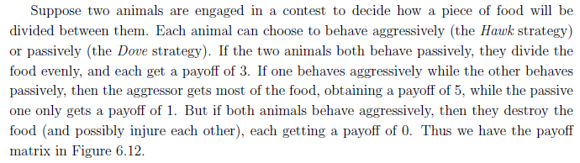
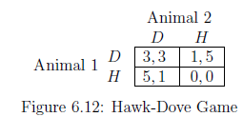
Multiple Equilibria:: e.g. anti-coordination
(G12) Hawk-Dove Game
Two Nash Equilibria: (D, H) and (H, D)
No unique prediction

Slide 27
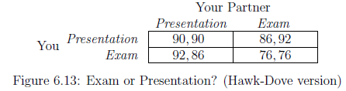
Two Nash equilibria:
(Presentation, Exam) and (Exam, Presentation)
Hawk-Dove game = Chicken game

Slide 28
Games with No Nash Equilibrium ➔ Mixed Strategies
For a game with no Nash Equilibrium
Enlarge the set of strategies to include the possibility of randomization
Once players are allowed to behave randomly, Nash equilibria always exist
E.g. Attack-defense games
Players: attacker and defender
Attacker’s strategies
A and B
Defender’s strategies
“defend against A” or “defend against B”

Slide 29
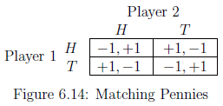
(G14) Matching Pennies Game (A simple attack-defense game)
H and T
If they match
Player 1 loses his penny to player 2
If they don’t match
Player 1 wins player 2’s penny
Also called “zero-sum game”
For any pair of strategies
One of the players wants to switch what they’re doing
Reason
one of the players gets a payoff of -1
and this player would improve his payoff to +1 by switching strategies

Slide 30
No Nash Equilibrium
Players keep switching their coins
Therefore, by simply having H or T, there’s no Nash Equilibrium in Matching Pennies Game
Recall that a pair of strategies form a Nash Equilibrium if
Even given knowledge of each other’s strategies, neither player would have an incentive to switch to an alternative strategy
But in Matching Pennies Game
If Player 1 knows that Player 2 chooses H or T
Then, Player can exploit this by choosing the opposite

Slide 31
Reality
Players generally try to make it difficult for their opponents to predict what they will play
Randomizing one’s behavior between H and T ➔ Mixed Strategies
Randomized behavior
Not choosing H or T directly
Choosing a probability with which she will play H
Player 1’s possible strategies: Not H and T
Numbers p between 0 and 1 (the probability that Player 1 will play H)
Player 2’s possible strategies: Not H and T
Numbers q between 0 and 1 (the probability that Player 2 will play H)

Slide 32
No longer two strategies by each player
A set of strategies: numbers in [0, 1]
“mixing“ between the options H and T
Referred as mixed strategies
If probability is 0 or 1
Play H or T
Referred as the two pure strategies
“p=1 by Player 1” = “pure strategy H”

Slide 33
Payoffs from Mixed Strategies
Each player will get
+1 with some probability
-1 with the remaining probability
Use expected payoff
While Player 2 chooses q
If Player 1 chooses pure strategy H
Player 1’s expected payoff: (-1)q+(1)(1-q) = 1-2q
If Player 1 chooses pure strategy T
Player 1’s expected payoff: (1)q+(-1)(1-q) = 2q-1

Slide 34
The mixed-strategy version of Matching Pennies game
Strategies: the probabilities of playing H
Payoffs: the expectations of payoffs from the four pure outcomes (H, H), (H, T), (T, H), (T, T)
Question
Is there a Nash equilibrium for this game?

Slide 35
Equilibrium with Mixed Strategies
Nash Equilibrium
A pair of strategies(now probabilities) so that each is a best response to the other
No pure strategy can compose a Nash Equilibrium
Question: What should Player 1’s best response be to the strategy q used by Player 2?
Expected payoff to player 1 from the pure strategy H: 1-2q
Expected payoff to player 1 from the pure strategy T: 2q-1
Key point
If 1-2q ≠ 2q-1, then H or T is the unique best response by Player 1
But, we already know that pure strategies cannot comprise Nash Equilibrium
Therefore, 1-2q=2q-1 in any Nash equilibrium, i.e. q=1/2
p=1/2 q=1/2 is the only possibility for a Nash equilibrium

Slide 36
Meaning of Mixed-Strategy Equilibrium
The strategy q=1/2 by Player 2
Makes Player 1 indifferent between playing H or T
i.e., the strategy q=1/2 is “non-exploitable” by Player 1
This is actually why we introduced randomization: each player wants their behavior to be unpredictable to the other, so that their behavior can’t be taken advantage of
Two choices of probabilities are best responses to each other
Nash proved that “every such game has at least one mixed-strategy equilibrium”

Slide 37
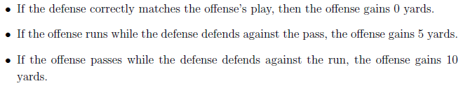
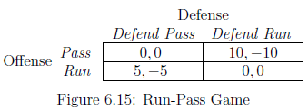
More on Mixed-Strategy Equilibrium (G15) Run-Pass Game
No Nash Equilibrium with pure strategies
Both need to randomize their behavior
p: the probability that the offense passes
q: the probability that the defense defends against the pass
From Nash’s result, at least one mixed-strategy equilibrium must exist

Slide 38
If the defense chooses a probability of q for defending against the pass
Expected payoff to the offense from passing: (0)(q)+(10)(1-q)=10-10q
Expected payoff to the offense from running: (5)(q)+(0)(1-q)=5q
To make the offense indifferent between its two strategies: 10-10q=5q, i.e., q=2/3
If the offense chooses a probability of p for passing
Expected payoff to the defense from defending against the pass: (0)(p)+(-5)(1-p)=5p-5
Expected payoff to the defense from defending against the run: (-10)(p)+(0)(1-p)=-10p
To make the defense indifferent between its two strategies: 5p-5=-10p, i.e., p=1/3

Slide 39
The only possible probability values that can appear in a mixed-strategy equilibrium
p=1/3 for the offense
q=2/3 for the defense
Expected payoff to the offense = 10/3
Expected payoff to the defense = -10/3
Question: Why not spend more time using your more powerful option, passing?
If the offense placed any higher probability on passing, then the defense’s best response would be to always defend against the pass, and the offense would actually do worse in expectation.
e.g. if p=1/2, the offense’s expected payoff is
(1/2)(0)+(1/2)(5)=5/2 < 10/3

Slide 40

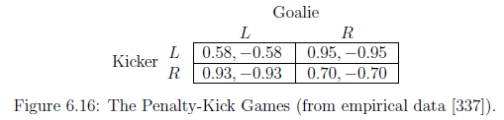
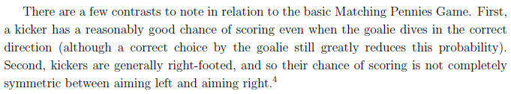
(G16) Penalty-Kick Game

Slide 41
Still, the basic premise of Matching Pennies present here
No equilibrium in pure strategies ➔ Randomize behavior in playing the game
If q is the probability that a goalie chooses L
Need to set q to make the kicker indifferent between his two options
(.58)(q)+(.95)(1-q) = (.93)(q)+(.70)(1-q)
By solving this equation, q=.42
Similarly, p=.39
Interestingly, in the real dataset,
The goalies dive left a .42 fraction of the time ➔ same as q
The kickers aim left a .40 fraction of the time ➔ only 0.01 different from p

Slide 42
How to find all Nash Equilibria (two-player, two-strategy game)
A game may have both pure-strategy and mixed-strategy equilibria
Therefore,
First, check all four pure outcome pairs
Then, check if there are any mixed-strategy equilibria
Check if there are mixing probabilities p and q that are best responses to each other

Slide 43
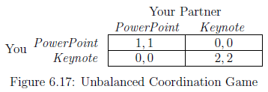
Both pure and mixed strategy equilibria
(G17) Unbalanced Coordination Game
It has two pure-strategy equilbria
(Powerpoint, Powerpoint), (Keynote, Keynote)
Also, it has mixed-strategy equilibrium
You: p on Powerpoint
Your partner: q on Powerpoint
You’ll be indifferent between Powerpoint and Keynote if
(1)(q)+(0)(1-q) = (0)q+(2)(1-q) ➔ q=2/3
p is also 2/3

